Slide 1


The role of the solvents in coordination chemistry
Al-Farabi Kazakh National University
Faculty of Chemistry and Chemical technology
Department of General and Inorganic Chemistry
PhD Bakhadur Askar

Slide 2

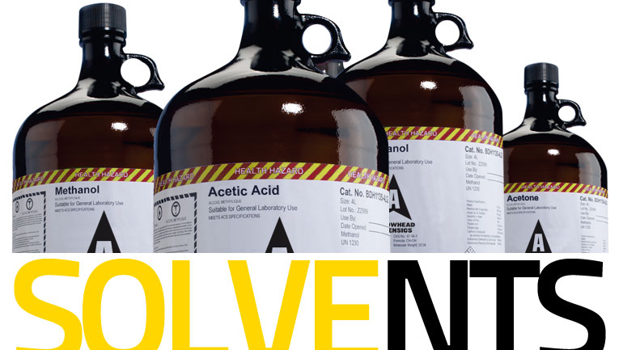
Importance of solvents
Solvents play a crucial role in coordination chemistry, influencing the formation, stability, and reactivity of metal complexes. They act not only as an inert medium but often as active participants in coordination equilibria and chemical transformations.
Solvents affect:
The thermodynamics of complex formation,
The kinetics of ligand substitution, and
The spectroscopic properties of metal ions.
Understanding solvent effects is essential for controlling reactions in both synthetic coordination chemistry and biochemical systems, where solvent interactions often determine structure and function.

Slide 3
Types of solvents in coordination chemistry
Protic solvents (e.g., water, alcohols) — capable of hydrogen bonding and proton transfer; they can coordinate through lone pairs on oxygen or nitrogen atoms.
Aprotic polar solvents (e.g., acetonitrile, dimethylformamide) — high dielectric constant, excellent at solvating cations, often act as ligands themselves.
Nonpolar solvents (e.g., benzene, toluene) — poor solvation ability; used when minimal solvent–solute interaction is desired.

Slide 4

Solvent coordination and solvation
In many systems, the solvent molecules directly coordinate to the metal center, forming solvated metal ions such as $\left[Cu\left(H_{2}O{\left.)\right.}_{6}{\left.]\right.}^{2+}\right.\right.$or $\left[Ni\left(NH_{3}{\left.)\right.}_{6}{\left.]\right.}^{2+}\right.\right.$.
This process, known as solvation or solvate formation, involves:
Primary solvation shell — solvent molecules directly bound to the metal.
Secondary solvation shell — additional solvent layers held by hydrogen bonding or electrostatic interactions.
Solvent coordination profoundly affects:
The geometry of complexes,
The ligand exchange rate, and
The spectroscopic signatures (UV–Vis, IR, NMR).
Solvated species often act as intermediates in ligand substitution reactions, where solvent molecules are displaced by stronger ligands.

Slide 5


Influence of solvents on complex stability
The stability of coordination complexes depends strongly on solvent properties such as polarity, donor number, and acidity.
In polar solvents, ionic complexes are stabilized through electrostatic screening, favoring dissociation into solvated ions.
In less polar solvents, neutral complexes are more stable due to reduced dielectric screening.
Solvents with high donor ability can compete with ligands for coordination sites, sometimes displacing weakly bound species.
For example, the stability of $\left[Co\left(NH_{3}{\left.)\right.}_{6}{\left.]\right.}^{3+}\right.\right.$is reduced in strongly coordinating solvents such as dimethyl sulfoxide (DMSO) because solvent molecules can partially replace ammonia in the coordination sphere.
Thus, solvent effects must always be considered when interpreting equilibrium constants or reaction mechanisms.

Slide 6

Solvent polarity and dielectric effects
The dielectric constant of a solvent influences the extent of ion-pair formation and electrostatic interactions between charged species.
High dielectric solvents (like water) stabilize separated ions, promoting ionic dissociation and fast ligand exchange.
Low dielectric solvents (like ether or benzene) favor neutral or ion-paired complexes, often slowing substitution reactions.
Polarity also affects the activation energy of reactions involving charge separation, such as oxidation–reduction or proton transfer. In transition metal chemistry, changing the solvent polarity can shift redox potentials by altering solvation energies of the oxidized and reduced species.
Therefore, solvent polarity serves as a fine-tuning parameter in redox and catalytic processes.

Slide 7
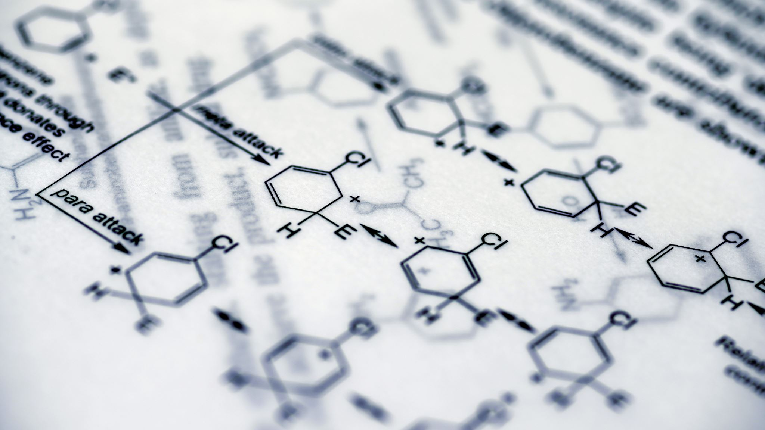
Solvent participation in ligand exchange and redox processes
In many coordination reactions, solvent molecules actively participate in chemical transformations.
Examples:
Solvent-assisted ligand substitution: In aqueous solutions, the incoming ligand may enter through a solvent bridge, forming a transient aqua complex.
Proton transfer reactions: Protic solvents can mediate proton exchange between ligands and metal centers, stabilizing charged intermediates.
Redox processes: Solvent molecules can act as electron donors or acceptors, influencing oxidation states or participating in electron transfer chains.
Thus, the solvent is not merely a background medium but a dynamic participant that facilitates complex formation and reaction kinetics.

Slide 8
Experimental and theoretical considerations
The study of solvent effects combines both experimental and theoretical approaches.
Spectroscopic methods (UV–Vis, NMR, IR, EXAFS) reveal how solvents alter coordination geometry and electronic transitions.
Kinetic measurements demonstrate solvent-dependent rates of ligand exchange or redox reactions.
Computational chemistry provides molecular-level insights into solvation shells, energy landscapes, and solvent–solute interactions.
Together, these techniques show that solvent molecules significantly shape the energetics, dynamics, and mechanisms of coordination reactions. Controlling solvent properties is therefore a key strategy in designing efficient and selective coordination processes.

Slide 9
Summary
Solvents play an active and multifaceted role in coordination chemistry, influencing thermodynamics, kinetics, and molecular structures.
Coordination and solvation determine the geometry, stability, and reactivity of metal complexes.
Solvent polarity and dielectric properties modulate ion-pairing, redox potentials, and ligand substitution rates.
Many reactions proceed through solvent-mediated pathways, emphasizing the dynamic interplay between solute and solvent.
Understanding solvent effects allows chemists to control complex formation, catalytic activity, and reaction selectivity.
In coordination chemistry, the solvent is an integral part of the chemical environment. By modifying solvation, coordination, and electronic interactions, solvents shape the very nature of metal–ligand systems. Mastering solvent effects is essential for rational design of coordination compounds in catalysis, materials science, and bioinorganic chemistry.

Slide 10

Thank you for attention!

